Slide 1

ADVANCED DATA STRUCTURES
Neena Thomas
Don Bosco College
Angadikadavu
Kannur

Slide 2
Contents
What is data structure?
Bag
Hash Table
Trie
Operations
Applications

Slide 3
Data Structure
A data structure is a way of storing data that implements certain operations .
A data structure should take ownership of its data.

Slide 4
1. Bag
A bag is an unordered collection of objects, where you can keep adding objects to the bag.
Bag is used to store same or different types of elements in it.
The elements are not ordered, they are in random order.

Slide 5
Operations
bag() - to create an empty bag.
add(Item) - to add an item to the bag.
isEmpty() - to check whether the bag is empty.
size() - to get the number of items in the bag.
remove() - remove an item from bag.

Slide 6
Application
Spelling checker.

Slide 7
2. Hash Tables
A hash table (hash map) is a data structure that implements an associative array abstract data type, a structure that can map keys to values.
It uses hash function.

Slide 8
The hash function transform the key into an array of index.
Each entry in the array is called Bucket

Slide 9
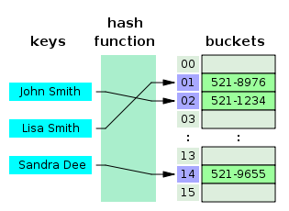

Slide 10
Operations
insert -inserting new record.
delete -delete existing record.
lookup –check for particular record.

Slide 11
Applications
Caches.
Object representation.

Slide 12
3. Trie
An ordered tree data structure used to store a dynamic set or associative array where the keys are usually strings.
A trie, also called digital tree, or prefix tree is a kind of search tree.

Slide 13
Operations
insert
Search
delete

Slide 14
Applications
As a dictionary.
Tries and Web Search Engines.

Slide 15
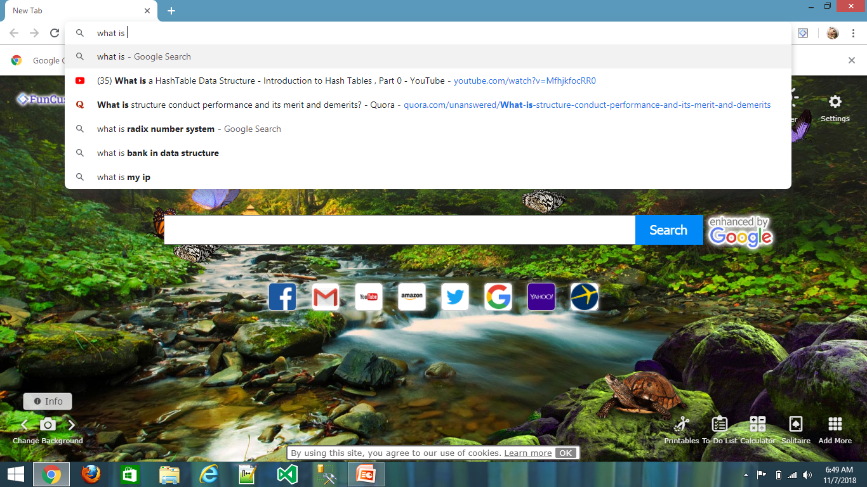

Slide 16

Thank you.

